Slide 1
Software Engineer Getting Start

Slide 2
Software Engineer career path
Build your own CV
Interview

Slide 3
Do What You Love. Love What You Do

Slide 4
Software Engineer career path
Software engineer is a person who applies the principles of software engineering to the design, development, maintenance, testing, and evaluation of the software that make computers or other devices containing software work.

Slide 5
13 Types of Software Engineer
Front End
Mobile
Gaming
Back-end
Application
Data Science
QA / QC
Algorithms ​
Embedded​
OS​
DEV-OPS ​
Full Stack​
Language – Compiler

Slide 6
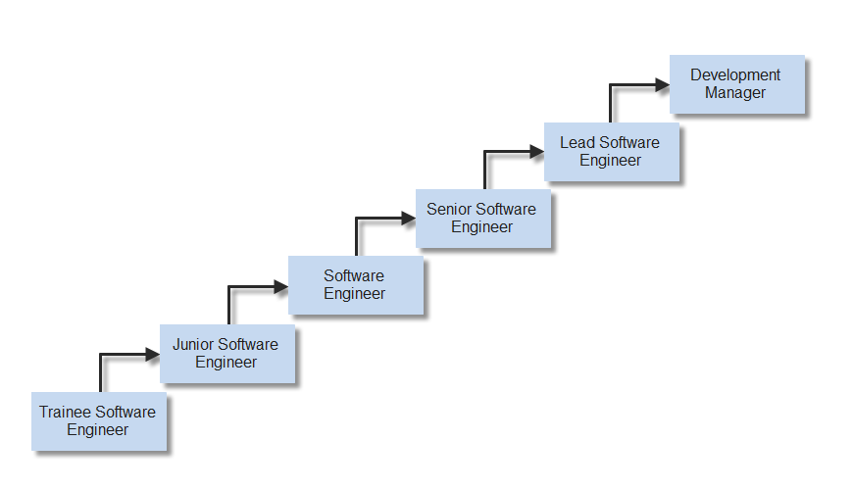
Developer Career

Slide 7
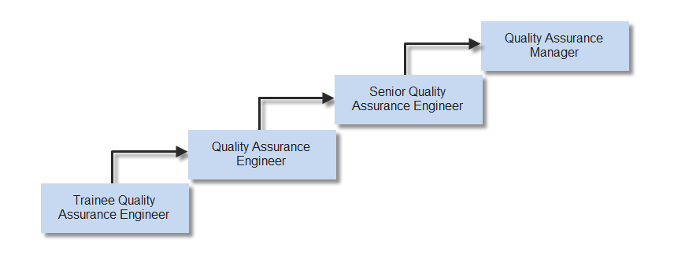
Tester Career

Slide 8
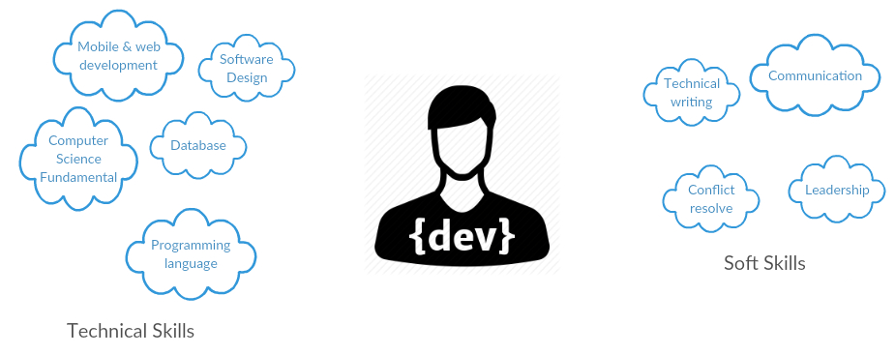
Software Engineer Skillset

Slide 9

Build your own Resume

Slide 10
Build your own Resume
Github, linkedin, stackoverflow....
Online CV
Short bio
Career wish
Working experiences, working skill
Soft skills
Certification & awards
References
Linkedin

Slide 11
Interview
What we need to prepare for interview
English
Research the organization.
Compare your skills and qualifications to the job requirements.
Prepare responses
Plan what to wear.
Plan what to bring
Eyes contact

Slide 12
5 ways to make a good impression
Positivity
Body language
Clarity
Enthusiasm
Feedback

Slide 13
Thanks you for listening

